Slide 1
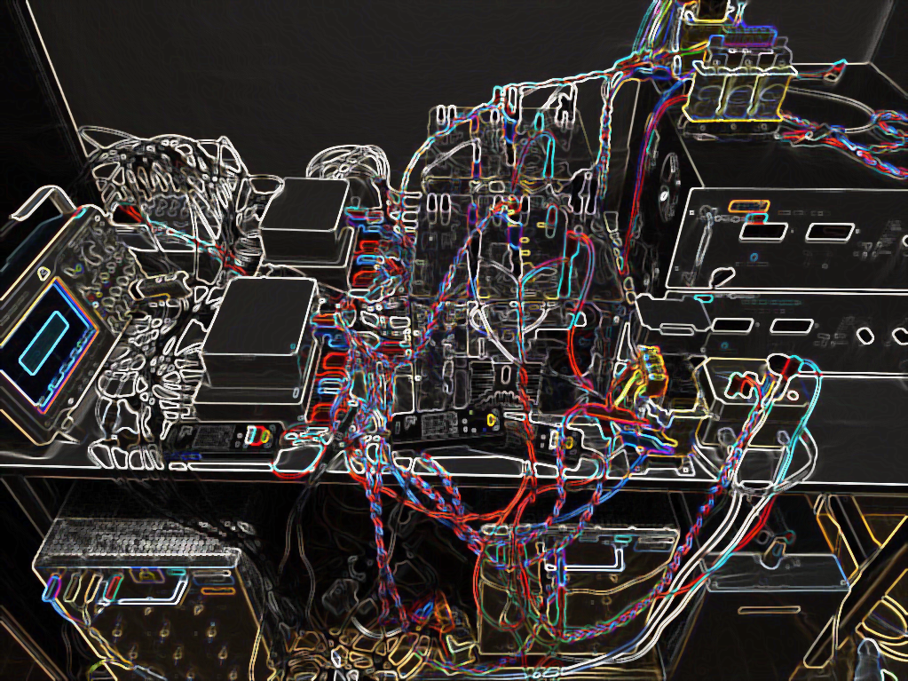
Neural network-based imitation of model predictive control for power converters
Aitor Teran, Cristina Roche, Pere Izquierdo

Slide 2
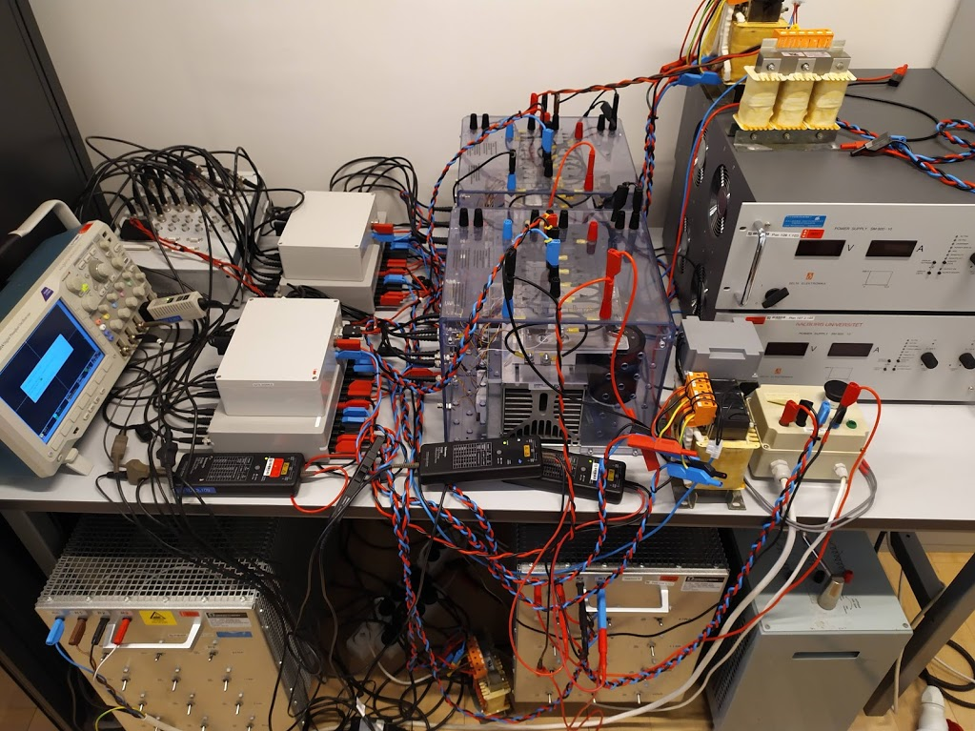
CONTENT
FS-MPC
ANN IMITATOR METHOD
RESULTS
CONCLUSION
REFERENCES

Slide 3
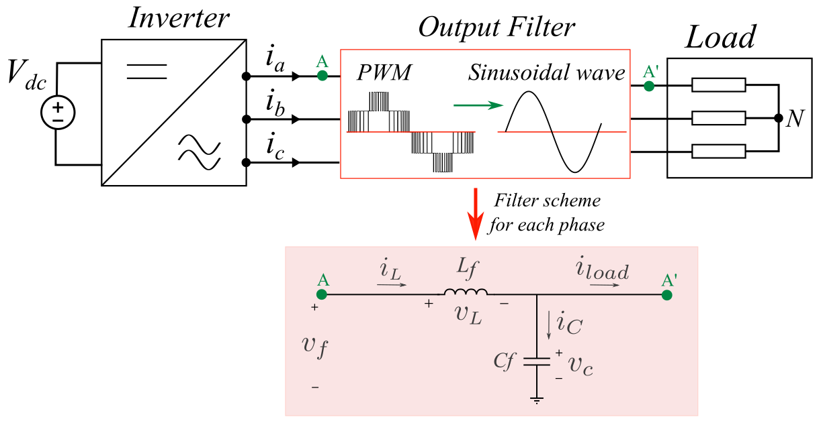
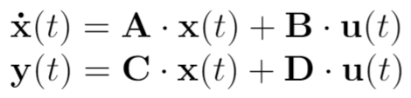
MODEL
Notes:
Explain the phases of the strategy process
Transition to the next slide:
Each executive manager has been responsible for preparing action plans for the implementation of the strategy within their area in collaboration with a cross-organisational group of management representatives.
The actual implementation of initiatives has also been based on this cross-organisational division of responsibilities in which follow-up and monitoring have been carried out by members of the Executive Management.

Slide 4
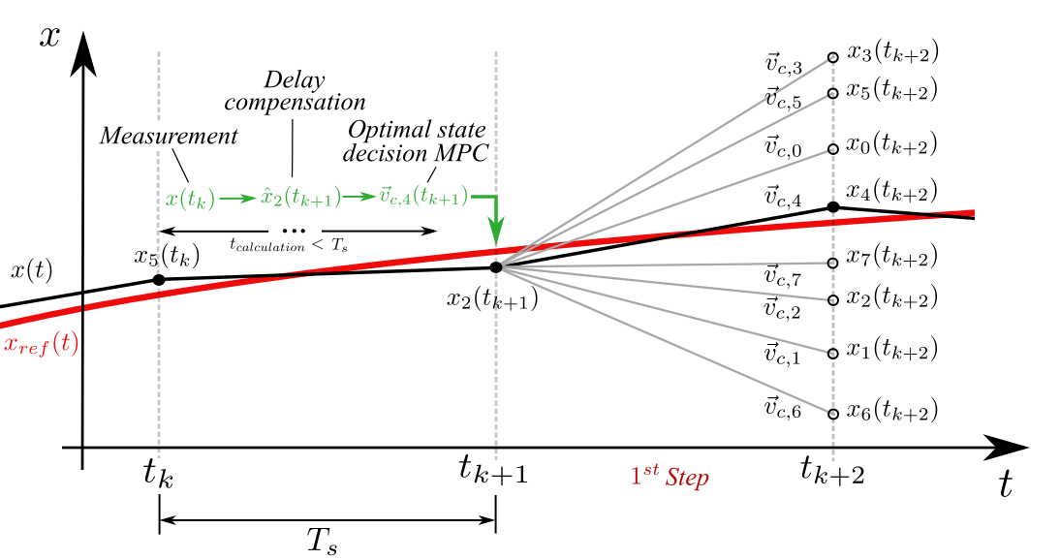
FS-MPC
This model is discretized and implemented in an FS-MPC algorithm, which solves in real time the optimization problem corresponding to minimizing the error between predicted output and reference voltages.
Notes:
Explain the phases of the strategy process
Transition to the next slide:
Each executive manager has been responsible for preparing action plans for the implementation of the strategy within their area in collaboration with a cross-organisational group of management representatives.
The actual implementation of initiatives has also been based on this cross-organisational division of responsibilities in which follow-up and monitoring have been carried out by members of the Executive Management.

Slide 5
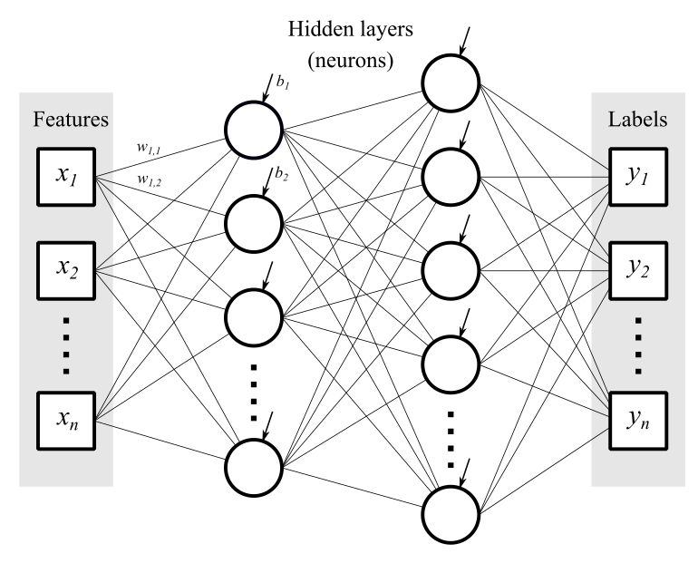
PROPOSED SOLUTION
Low computational burden.
Ability to imitate different controllers.
Notes:
Explain the phases of the strategy process
Transition to the next slide:
Each executive manager has been responsible for preparing action plans for the implementation of the strategy within their area in collaboration with a cross-organisational group of management representatives.
The actual implementation of initiatives has also been based on this cross-organisational division of responsibilities in which follow-up and monitoring have been carried out by members of the Executive Management.

Slide 6
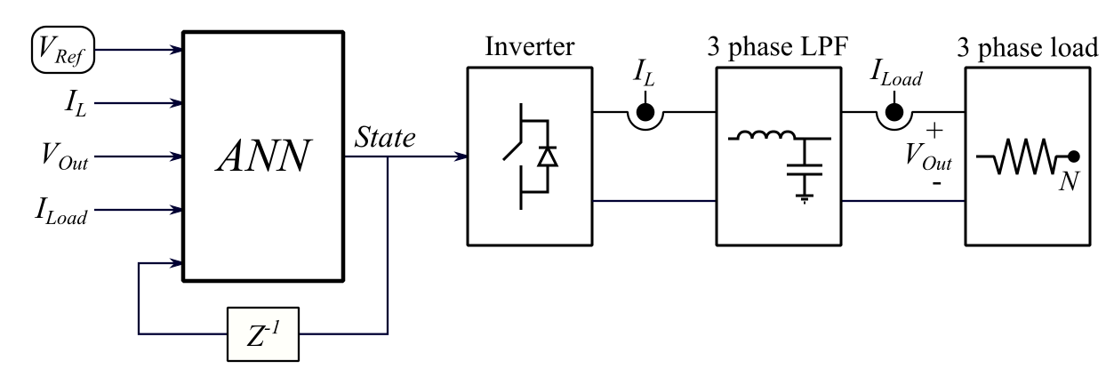
DATA ADQUISITION
2 million training data points
1 million random validation and test data points
Notes:
Explain the phases of the strategy process
Transition to the next slide:
Each executive manager has been responsible for preparing action plans for the implementation of the strategy within their area in collaboration with a cross-organisational group of management representatives.
The actual implementation of initiatives has also been based on this cross-organisational division of responsibilities in which follow-up and monitoring have been carried out by members of the Executive Management.

Slide 7
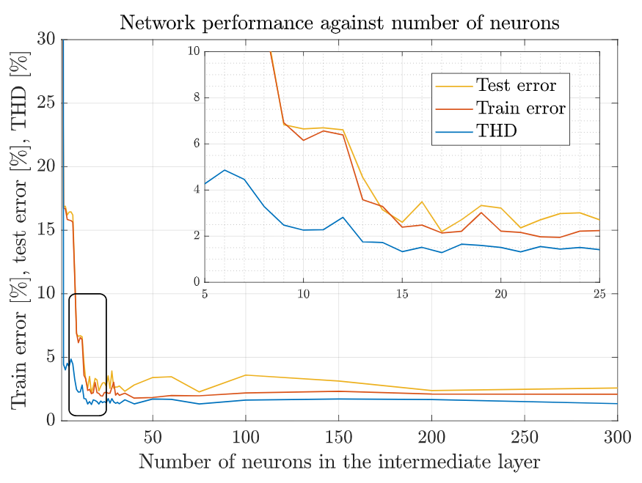
TRAINING THE NETWORK
Finding optimal network configuration.
1 hidden layer with 15 neurons.
Notes:
Explain the phases of the strategy process
Transition to the next slide:
Each executive manager has been responsible for preparing action plans for the implementation of the strategy within their area in collaboration with a cross-organisational group of management representatives.
The actual implementation of initiatives has also been based on this cross-organisational division of responsibilities in which follow-up and monitoring have been carried out by members of the Executive Management.

Slide 8
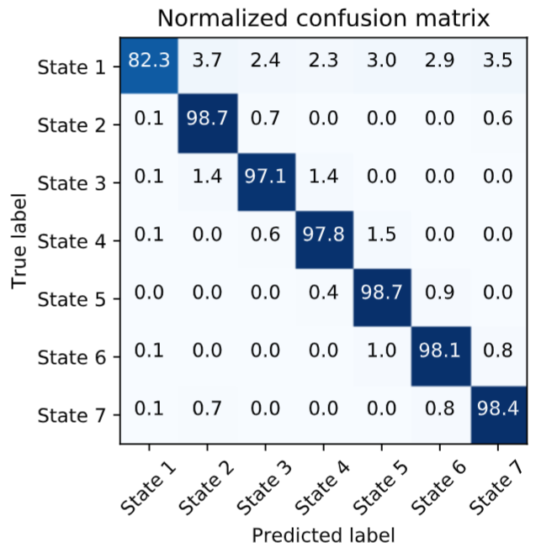
TRAINING THE NETWORK
Total test accuracy of 98,05% for 1-step ahead MPC.
Less State 1 training data give lower accuracy.
Notes:
Explain the phases of the strategy process
Transition to the next slide:
Each executive manager has been responsible for preparing action plans for the implementation of the strategy within their area in collaboration with a cross-organisational group of management representatives.
The actual implementation of initiatives has also been based on this cross-organisational division of responsibilities in which follow-up and monitoring have been carried out by members of the Executive Management.

Slide 9
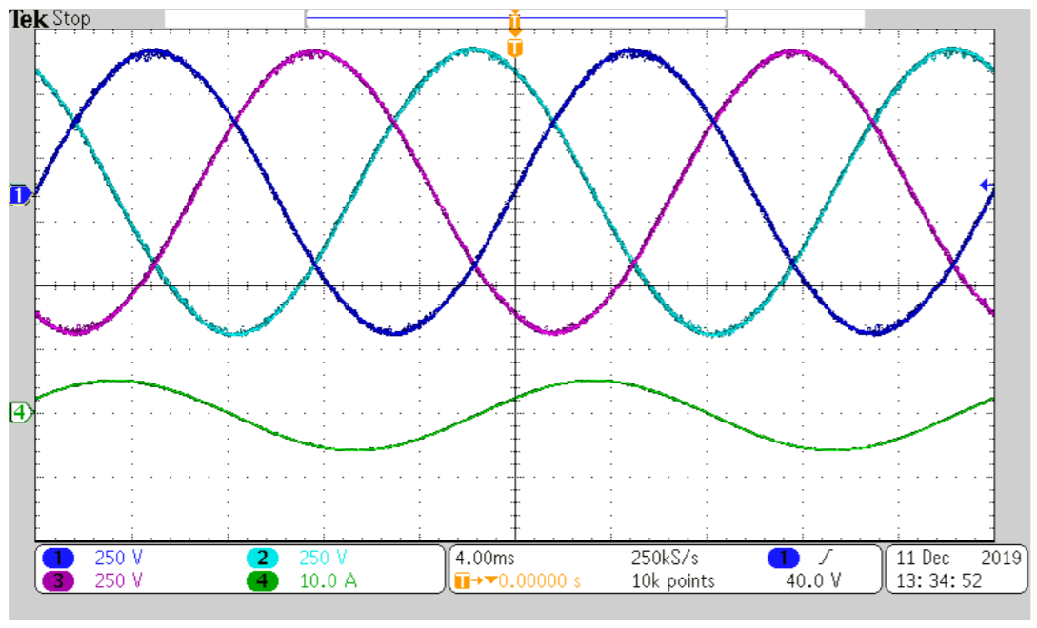
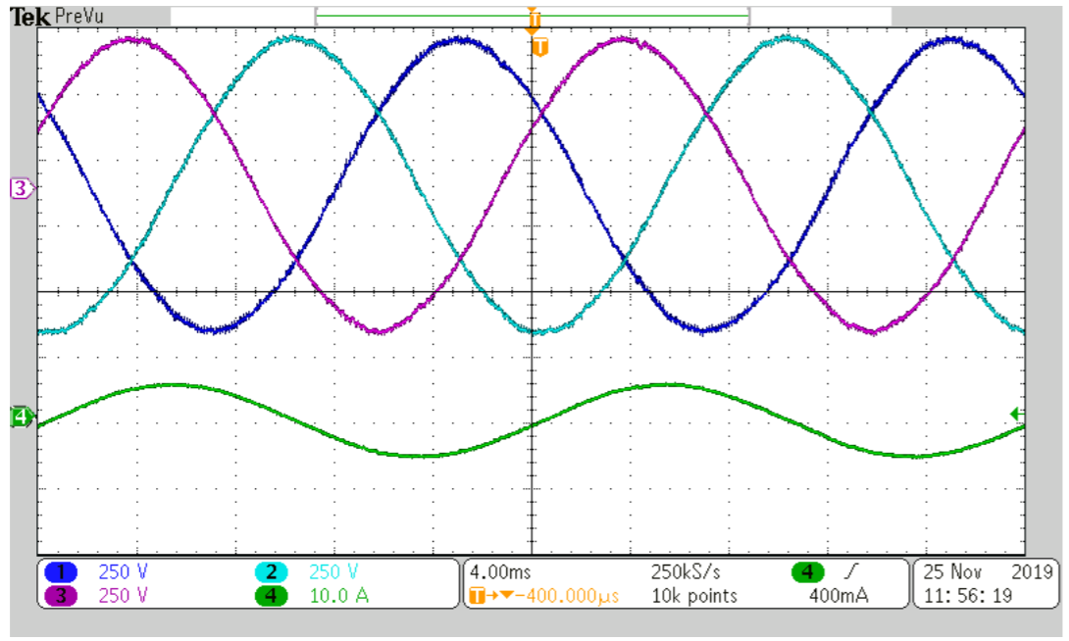
RESULTS
MPC
Why is the same Figure twice?
ANN
Notes:
Explain the phases of the strategy process
Transition to the next slide:
Each executive manager has been responsible for preparing action plans for the implementation of the strategy within their area in collaboration with a cross-organisational group of management representatives.
The actual implementation of initiatives has also been based on this cross-organisational division of responsibilities in which follow-up and monitoring have been carried out by members of the Executive Management.

Slide 10
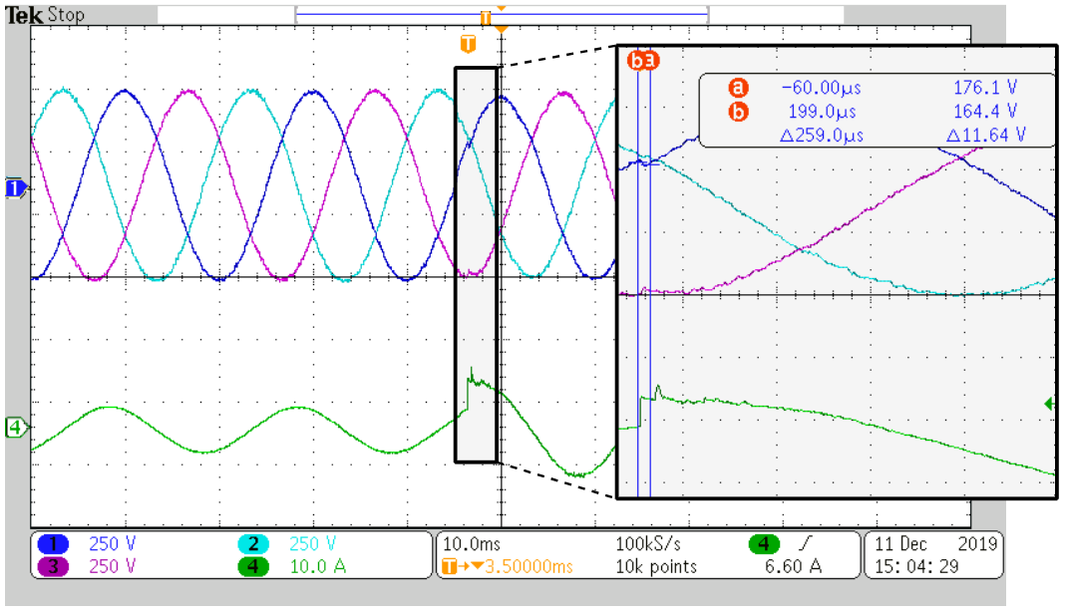
RESULTS
Transient response
Notes:
Explain the phases of the strategy process
Transition to the next slide:
Each executive manager has been responsible for preparing action plans for the implementation of the strategy within their area in collaboration with a cross-organisational group of management representatives.
The actual implementation of initiatives has also been based on this cross-organisational division of responsibilities in which follow-up and monitoring have been carried out by members of the Executive Management.

Slide 11
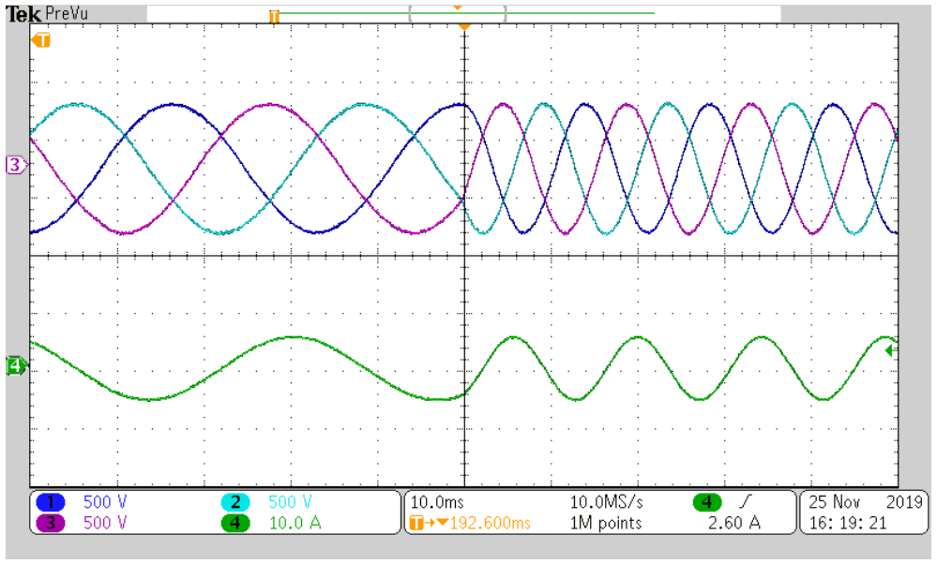
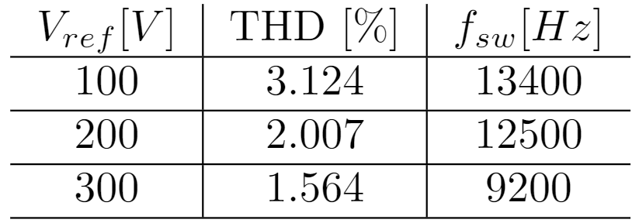
RESULTS
Robustness
ANN imitators are able to extrapolate to data points for which they have not been trained
Robust to reference frequency and voltage changes
Notes:
Explain the phases of the strategy process
Transition to the next slide:
Each executive manager has been responsible for preparing action plans for the implementation of the strategy within their area in collaboration with a cross-organisational group of management representatives.
The actual implementation of initiatives has also been based on this cross-organisational division of responsibilities in which follow-up and monitoring have been carried out by members of the Executive Management.

Slide 12

THANK YOU
THANK YOU

